Slide 1
Appendix 1
Sites
Initial concept drawing

Slide 2
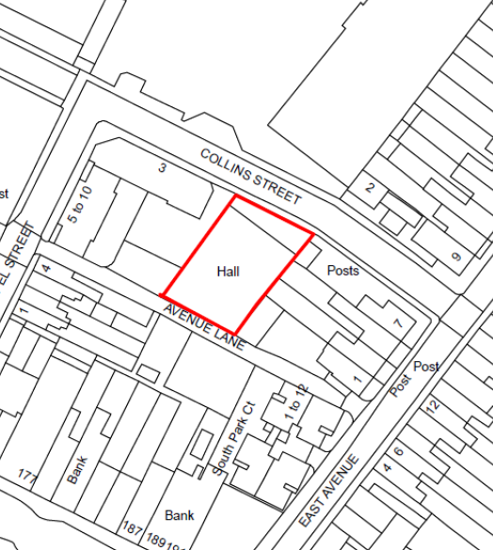
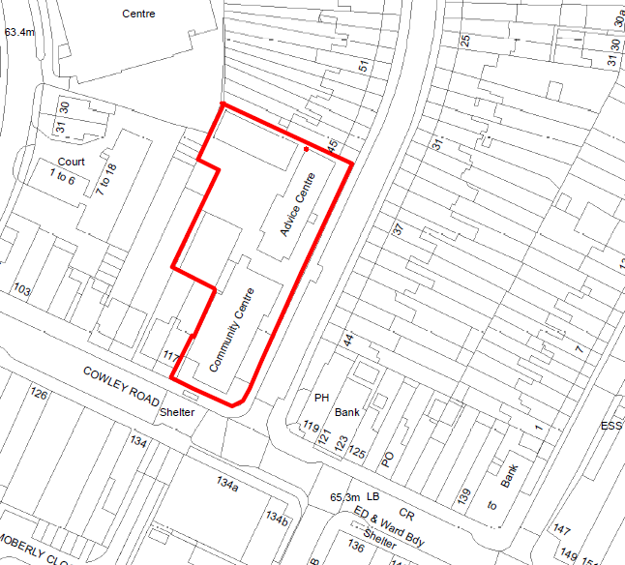
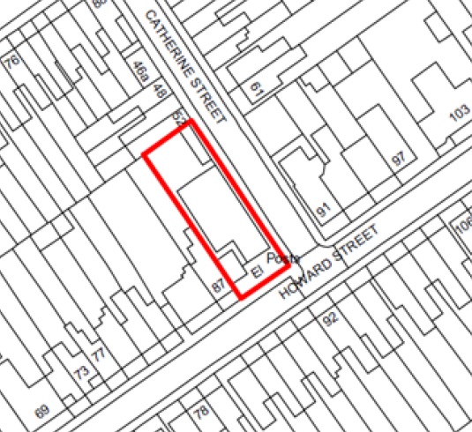
Appendix 1: The three sites for development associated with East Oxford Community Centre

Slide 3
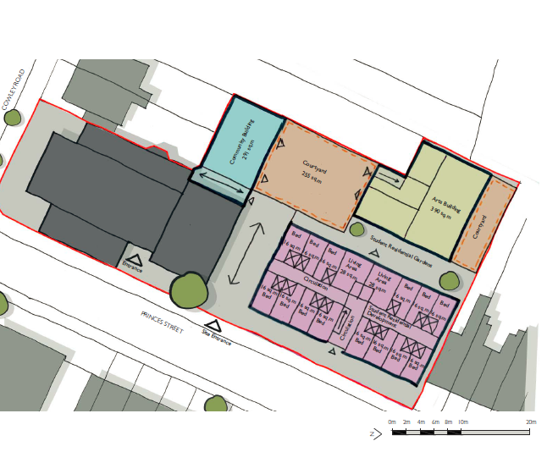
Initial concept drawing
Notes:
Indicative Layout only and is likely to be amended as part of detailed design
Original concept included student housing, residential housing is now proposed
Community centre to cover 900m2 (equivalent to existing space on site)
Refurbishment of existing community Centre with some new buildings
New building regulations for public buildings to build to almost carbon neutral from September 2020

